Slide 1
TELCOM CUSTOMER DATASET PROJECT
NAME :M.DHANUSHPRIYA
COURSE : ADVANCE DATA ANALYTICS.

Slide 2
OBJECTIVES
Customers who left within the last month – the column is called Churn
Services that each customer has signed up for – phone, multiple lines, internet, online security, online backup, device protection, tech support, and streaming TV and movies
Customer account information – how long they’ve been a customer, contract, payment method, paperless billing, monthly charges, and total charges
Demographic info about customers – gender, age range, and if they have partners and dependents

Slide 3
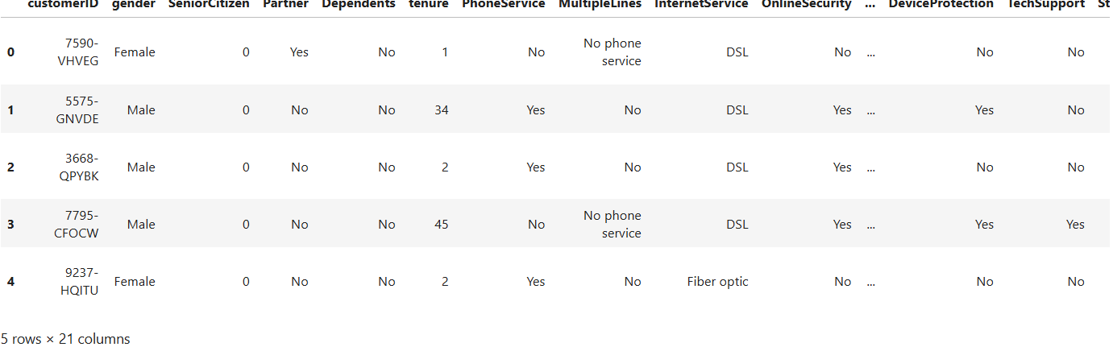
DATA SOURCE
df = pd.read_csv('Telco-Customer-Churn.csv')df.head()
customerID ,gender, SeniorCitizen ,Partner, Dependents, tenure, PhoneService ,MultipleLines, InternetService, OnlineSecurity, OnlineBackup, DeviceProtection, TechSupport, StreamingTV ,StreamingMovies, Contract, PaperlessBilling ,PaymentMethod, MonthlyCharges, TotalCharges, Churn
COLUMN NAMES

Slide 4
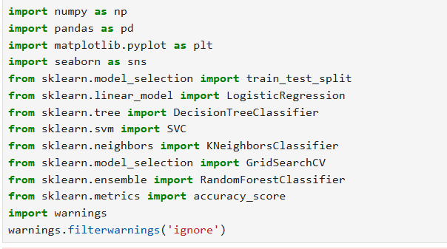
LIBRARYS TO BE IMPORT

Slide 5
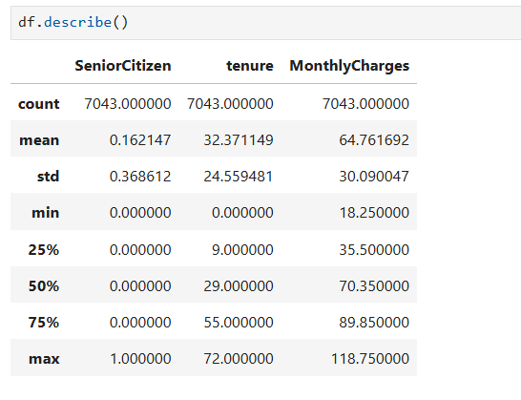
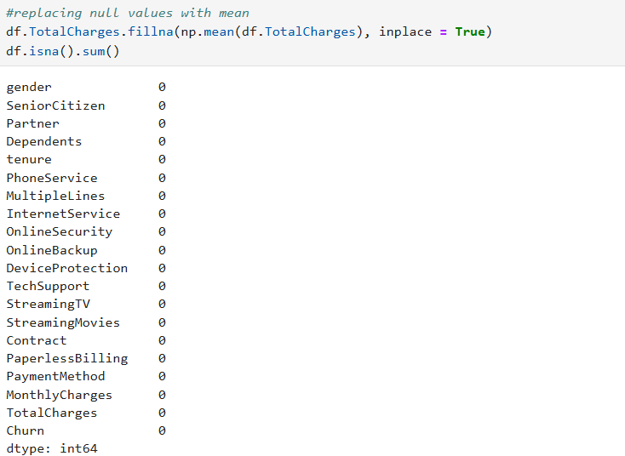
STATISTICAL SUMMARY OF DATAFRAME
REPLACE THE NULL VALUE WITH MEAN VALUE

Slide 6
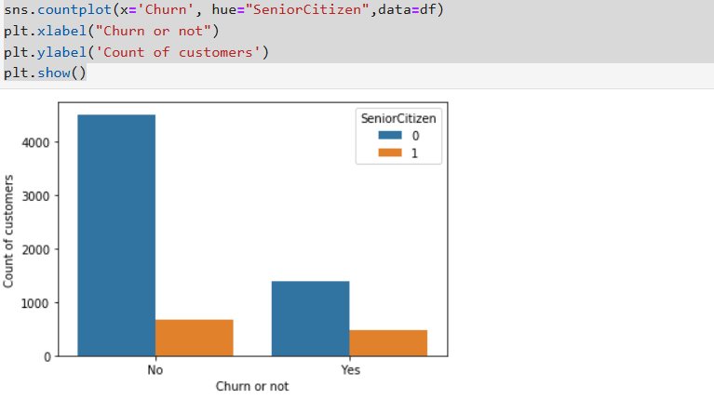
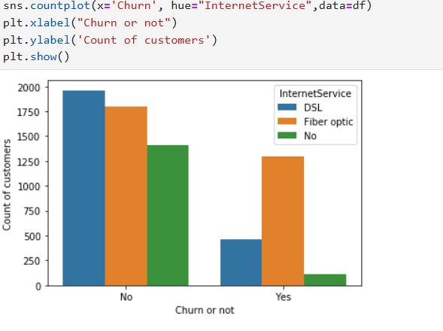
SENIOR CITIZON ANALYSIS USING CHURN
INTERNET IMPACT ON CHURN

Slide 7
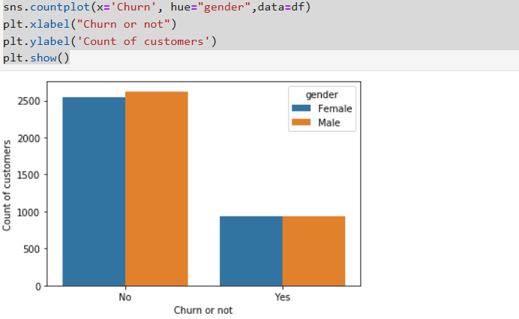
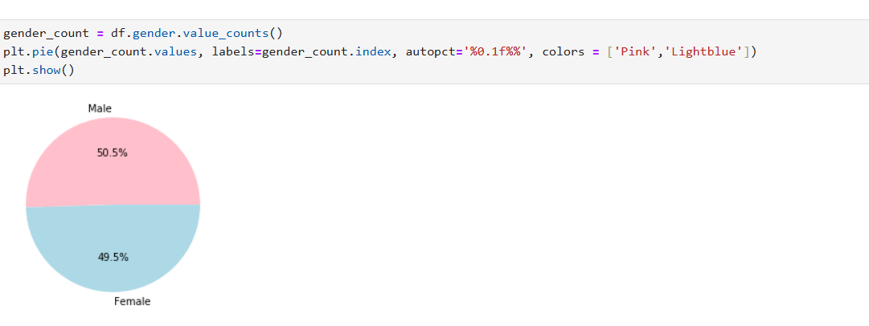
GENDER IMPACT IN CHURN

Slide 8
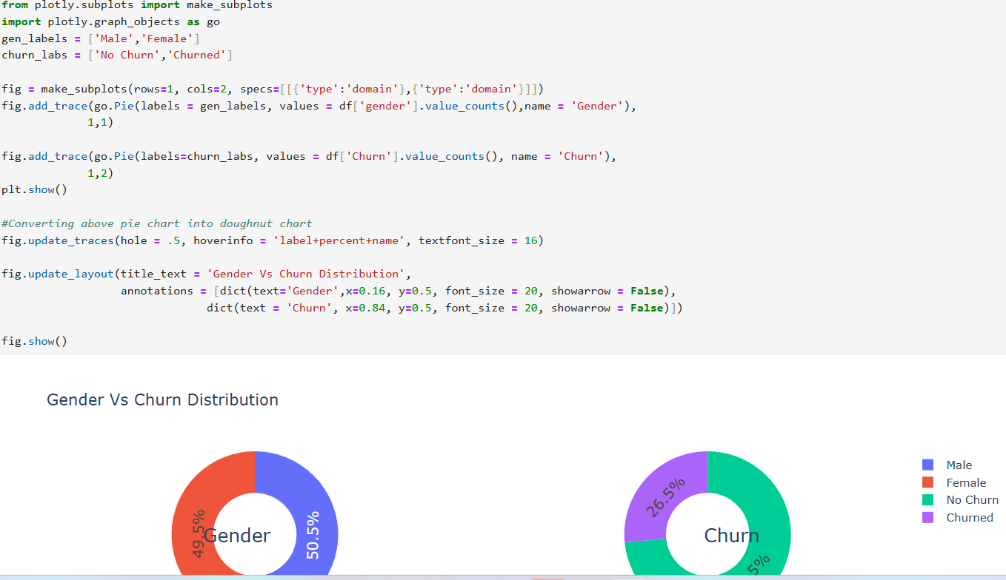
TO GIVE THE DISTRIBUTION OF GENDER AND CHURN

Slide 9
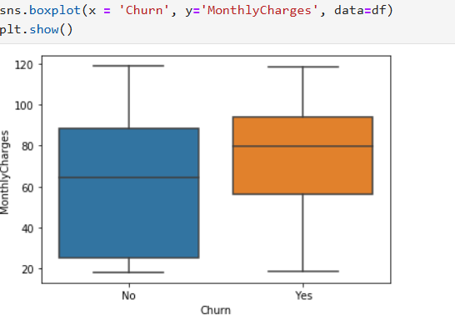
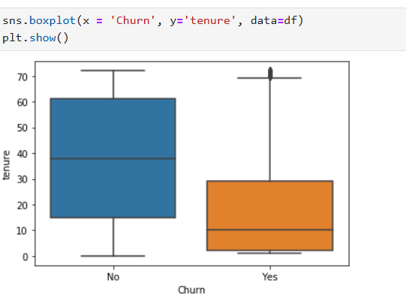
Montly charges distribution usign box plot for churn and not churn

Slide 10
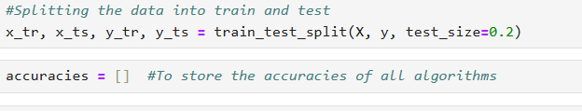
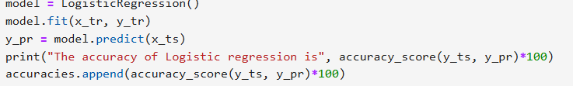
SPLITTING THE DATA INTO TRAIN AND TEST
APPLY LOGISTIC REGRESSION
RESULT

Slide 11
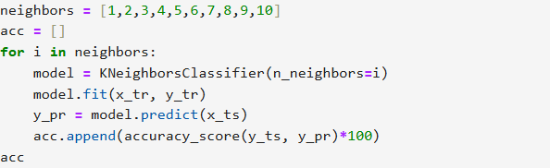
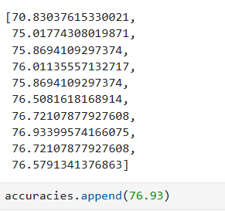
KNN CLASSIFICATION
CLASSIFIES THE DATA POINTS BY COMPARING THEM TO THEIR MOST SIMILAR NEIGHBORS
KNN IS POPULAR ALGORITHEM AND SIMPLE ALGORITHEM THAT CAN BE USED FOR CLASSIFICATION And REGRESSION
RESULT

Slide 12
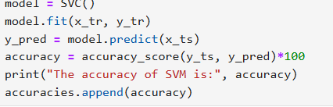
SUPPORT VECTOR MACHINES
FIND THE OPTIMAL DECISION BOUNDARY BETWEEN CLASSES BY MAXIMIZING THE MARGIN BETWEEN THEM
HANDLE COMPLEX AND HIGH DIMENTIONAL DATA SUCH AS IMAGES
RESULT

Slide 13
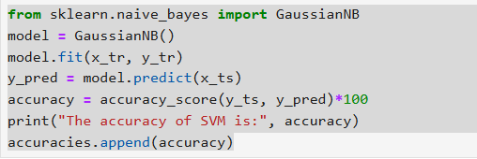
NAÏVE BAYES
NAÏVE BAYES ALGORITHEM IS ONE OF CRUSIAL ALGORITHEMS IN MACHINE LEARNING THAT HELPS WITH CLASSIFICATION PROBLEMS.
RESULT

Slide 14
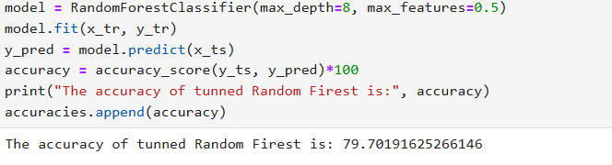
RANDOM FOREST CLASSIFIER
Random Forest algorithm is a powerful tree learning technique in Machine Learning.
It works by creating a number of Decision Trees during the training phase. Each tree is constructed using a random subset of the data set to measure a random subset of features in each partition.
This randomness introduces variability among individual trees, reducing the risk of overfitting and improving overall prediction performance.

Slide 15
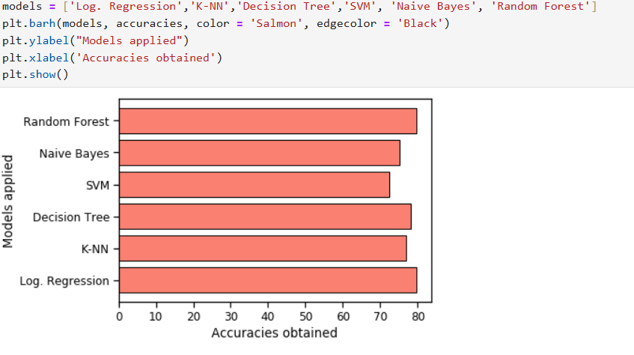
comparison of accuracies

Slide 16
THANK YOU

